Slide 1



AVL TREE
Presented By
Sheikh Sarafat Hossain
2022-3-60-109

Slide 2
01.
INTRODUCTION
02.
CHARACTERISTICS OF AVL TREE
03.
APPLICATION OF AVL TREE
04.
DIFFERENCE BETWEEN AVL TREE AND B- TREE
05.
PROS AND CONS
TABLE OF
CONTENT

Slide 3
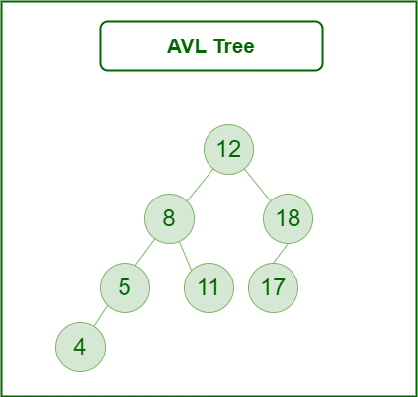
INTRODUCTION
An AVL tree defined as a self-balancing Binary Search Tree (BST) where the difference between heights of left and right subtrees for any node cannot be more than one.
It is height balanced tree
It is a binary search tree
It is a binary tree in which the height difference between the left subtree and right subtree is almost one
Height is the maximum depth from root to leaf

Slide 4
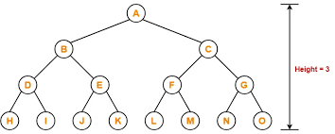
CHARACTERISTICS OF AVL TREE:
It follows the general properties of a Binary Search Tree.
Each subtree of the tree is balanced, i.e., the difference between the height of the left and right subtrees is at most 1.
The tree balances itself when a new node is inserted. Therefore, the insertion operation is time-consuming

Slide 5
APPLICATION OF AVL TREE:
Most in-memory sets and dictionaries are stored using AVL trees.
Database applications, where insertions and deletions are less common but frequent data lookups are necessary, also frequently employ AVL trees.
In addition to database applications, it is employed in other applications that call for better searching.
Most STL implementations of the ordered associative containers (sets, multisets, maps and multimaps) use red-black trees instead of AVL trees.

Slide 6
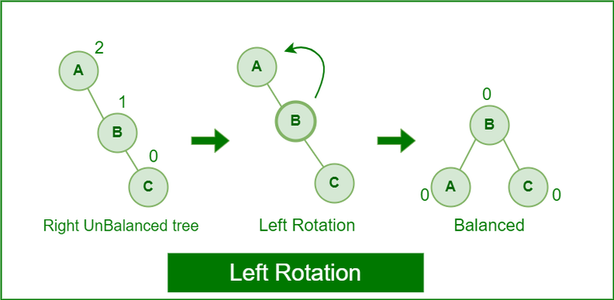
LEFT ROTATION
When a node is added into the right subtree of the right subtree, if the tree gets out of balance, we do a single left rotation.

Slide 7
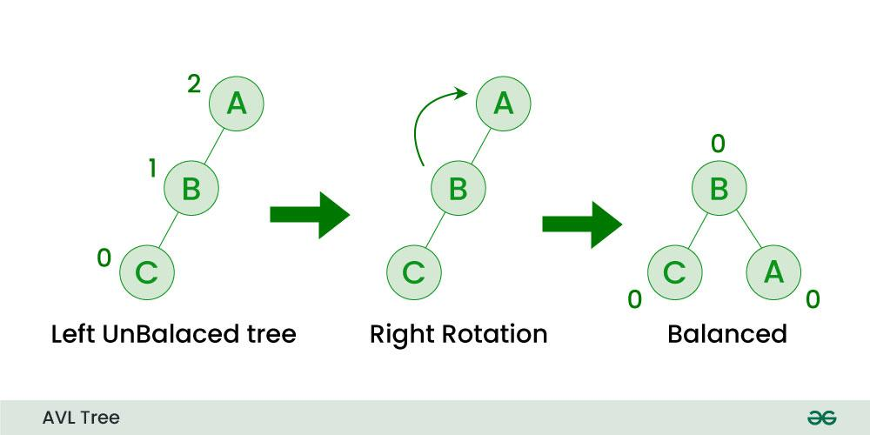
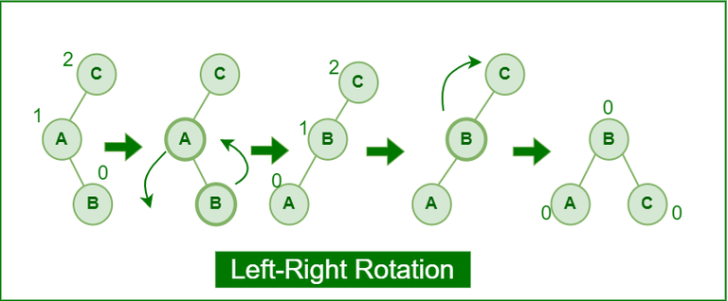
RIGHT ROTATION
If a node is added to the left subtree of the left subtree, the AVL tree may get out of balance, we do a single right rotation.

Slide 8
LEFT-RIGHT ROTATION
A left-right rotation is a combination in which first left rotation takes place after that right rotation executes.

Slide 9
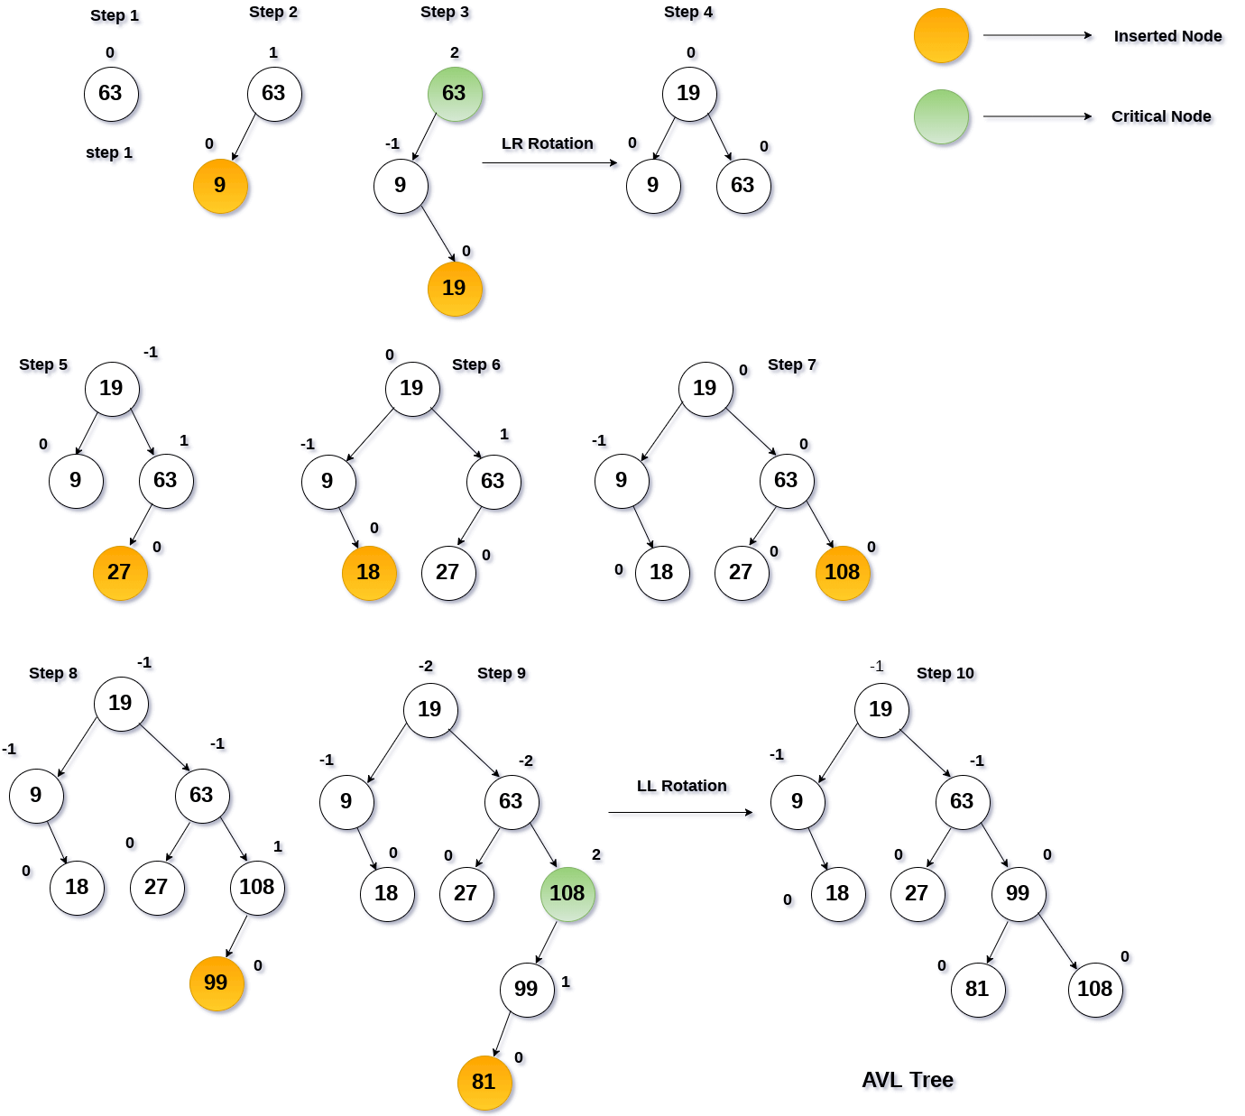
INSERTION IN AVL TREE:

Slide 11
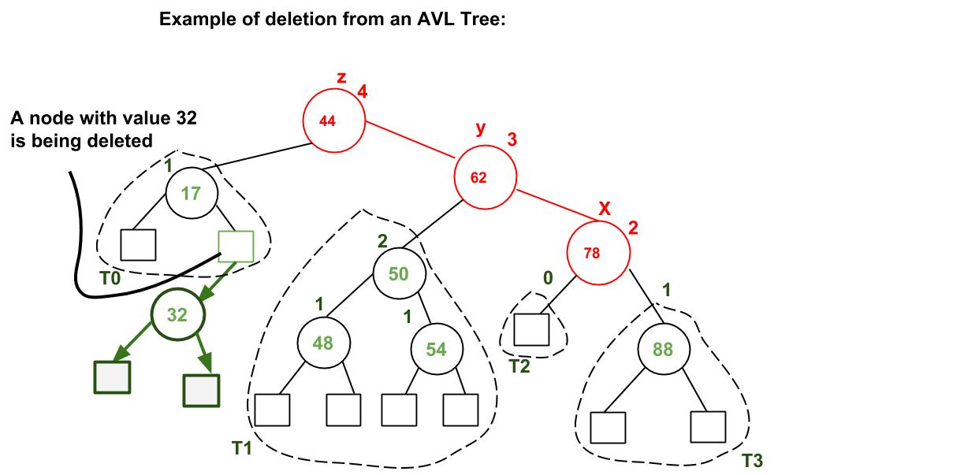

Slide 12
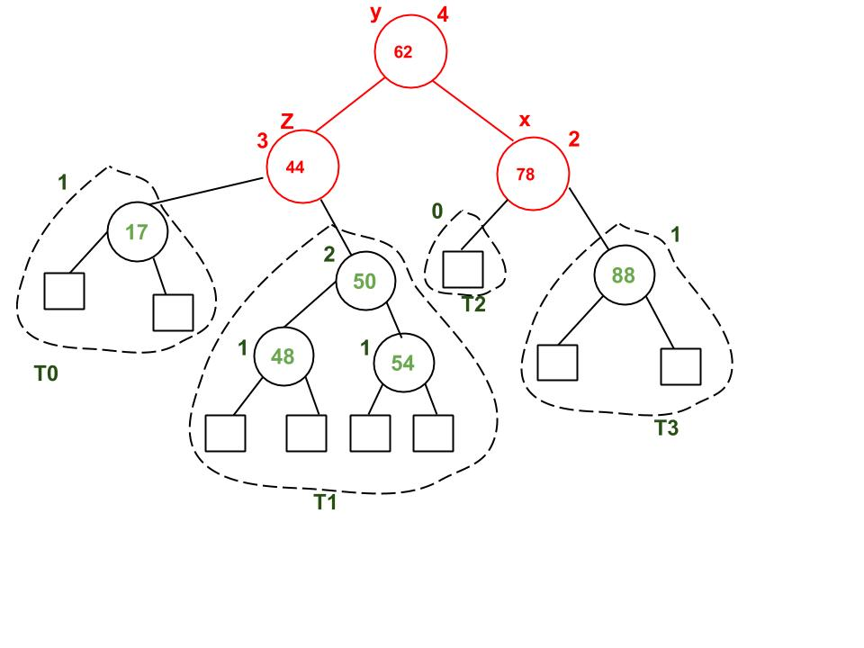

Slide 13
HOW IS AN AVL TREE DIFFERENT FROM A B-TREE?
AVL Tree
B-Tree
It is a self-balancing binary search tree
Every node contains at most 2 child nodes
AVL tree has a height of log(N) (Where N is the number of nodes)
AVL tree has a height of log(N) (Where N is the number of nodes)..
It is a multi-way tree(N – ary tree).
In this tree, nodes can have multiple child nodes
B-tree has a height of log(M*N) (Where ‘M’ is the order of tree and N is the number of nodes).
Every node except the root must contain at least t-1 keys. The root may contain a minimum of 1 key.

Slide 14
PROS AND CONS
It is surely not skewed.
It provides faster lookups than Red-Black Trees
Better searching time complexity compared to other trees like binary tree.
Height cannot exceed log(N), where, N is the total number of nodes in the tree.
It is difficult to implement.
Less used compared to Red-Black trees.
AVL trees provide complicated insertion and removal operations as more rotations are performed.
Take more processing for balancing.

